Slide 1
IBM DataSCIENCE CAPTSTONE Project
The BATTLE OF NEIGHBORHOODS CHOOSING A LOCATION FOR OPENING A WAFFLE SHOP IN DOWNTOWN TORONTO
BY RAGHU GOPALKRISHNAN

Slide 2
BACKGROUND
A SUCCESSFUL EUROPEAN WAFFLE MANUFACTURER WANTS TO EXPAND THEIR FOOTPRINT IN North America
North America is a potential market and presents numerous opportunities to expand the waffle business
Their market research team has identified they have taken a decision to invest in downtown Toronto.
They have asked our datascience company to find the right neighbourhood to start a franchise based on relevant data, exploration and analysis.

Slide 3
Problem statement
Since Toronto is a large area choosing the right neighbourhood to open the waffle shop is crucial
Due to high real estate prices it is vital that the right location be chosen to avoid business losses.
If a right neighbourhood it could be detrimental to their expansion plans in north America.

Slide 4
Data requirements
List of neighbourhoods in Toronto according to boroughs. This information will be sourced from Wikipedia.
Geospatial information per postal code from a csv file.
List of venues per neighbourhood, this information will be obtained form the foursquare api.

Slide 5
Audience
The target audience for this project would be the management for the waffle company who are interested in opening their franchise in NA
This paper will also interest students of the datascience field as a reference

Slide 6
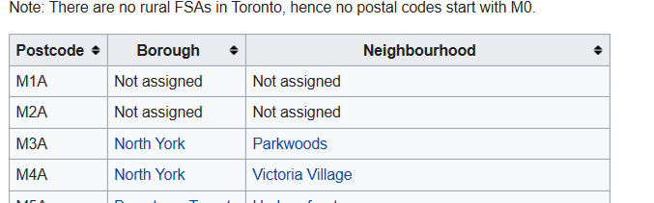

Data DESCRIPTION
List of neighbourhoods in Toronto according to boroughs. This information will be sourced from Wikipedia
Geospatial information per postal codes from a csv file.
List of venues per neighbourhood
This will be obtained using the foursquare api.

Slide 7
methodology
Obtain
Scrub
Interpret
Model
Explore
Step | Task
Obtain | Read data from Wikipedia, convert to DF Obtain Geospatial Data
Scrub | Remove unwanted data, retain only needed columns. Data wrangling
Explore | Use Foursquare API to obtain venue details
Model | Use K-means clustering methodology
Interpret | Interpret clustering results, draw conclusions

Slide 8
Scope
We will limit the scope of this project to the ‘downtown Toronto’ area
Rental prices, other influencing factors which might be detrimental to open a shop in an area are not within the scope of this project.
Customer demand, taste, preferences etc are not within the scope of this project.

Slide 9
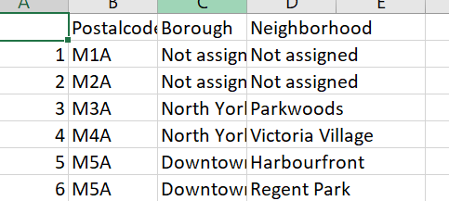
Data collection and processing
Step-1We used the python Wikipedia api to scrape the tabular data for the list of neighbourhoods in Toronto. We created a dataframe as follows
Step-2 here we did some data cleaning and data wrangling to remove unwanted data like rows with boroughs as ‘not assigned’ and some data wrangling

Slide 10
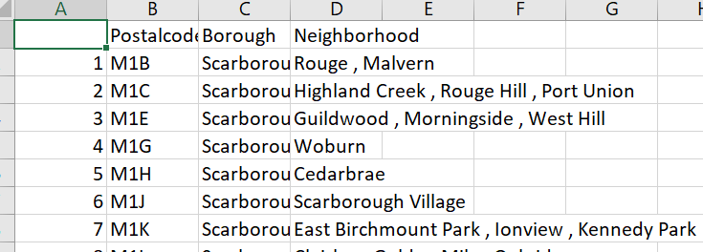
Data collection and processing contd..
Step-3We did some data aggregation to group on the postal code
Step-4 we used the geospatial file to get the longitude and latitude for the postal codes by merging two dataframes on the postal code column

Slide 11
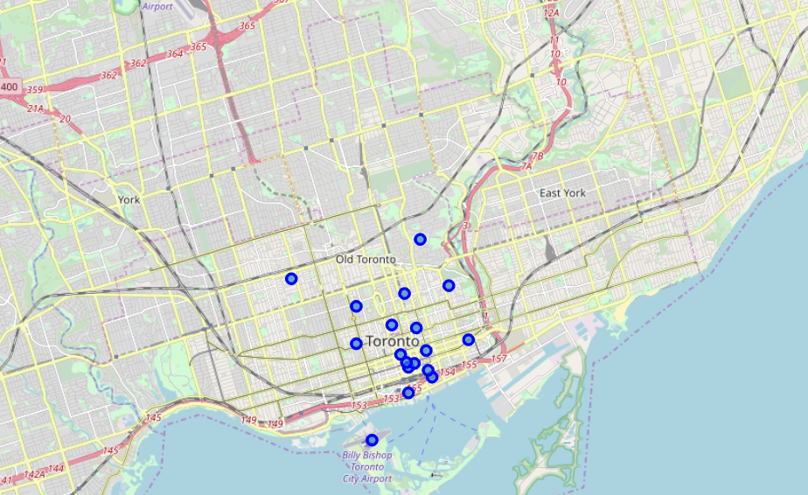
Data collection and processing contd..
Step-5 We created a map of downtown Toronto and superimposed the neighrbourhoods using folium

Slide 12
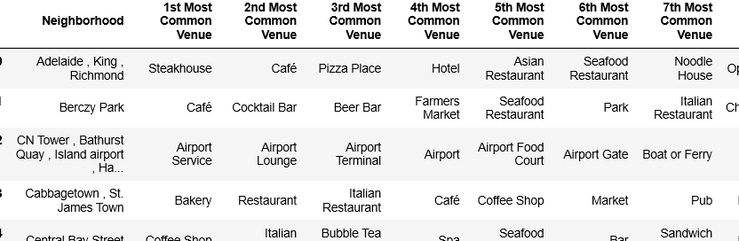
Data collection and processing contd..
Step-7 We use the foursquare api to explore venues close to our neighbourhoods

Slide 13
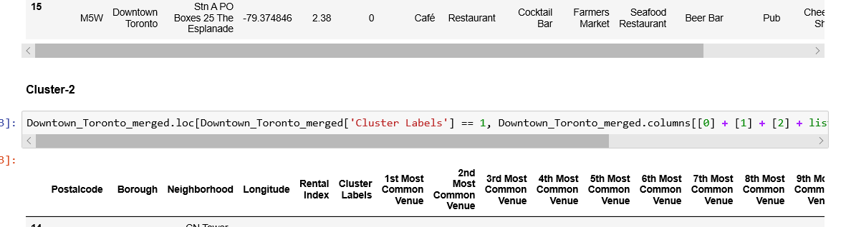
Data collection and processing contd..
Step-8 We use the k-means algorithm to cluster the neighbourhoods usling cluster=5

Slide 14
Analysis of data
After the last step of clustering using k-means algorithm we breakdown the neighbourhoods into clusters of similarity to help us with our analysis.
In the analysis step we analyse the neighbourhoods on various parameters of rental index, venues closeby etc to help us make a determination on which neighbourhood is suitable to open our waffle business.

Slide 15
Discussion of results
The findings from our analysis are
Cluster 1 and 4 has a high density of cafes, restaurants, Coffee shops
Cluster 2,3,5 has only one Neighborhood
In Cluster 1 Church and Wellesley, Ryerson , Garden District seem suitable venues due to their low rental index
In Cluster 5 Cabbagetown and Harbour Front seem suitable venues. Harbour front in particular seems interesting since there are breakfast spots and Bakery shops and Waffle could be a potential item which will be consumed.
The other Neighbourhoods have a relatively higher Rental Index and could be a risky proposition if the business doesn't take off well

Slide 16
conclusion
The purpose of our project was to identify suitable neighborhood's in the Downtown Toronto area which are suitable to open a Waffle franchise so that the Client Management of the Waffle company can narrow down to suitable areas to start their franchise business.
Using the Foursquare API we were able to identify venues closer to the neighborhood's and then alongwith the K-means clustering algorithm we were able to group the data on feature similarity in order to find suitable locations.
the final decision to select a neighbourhood will be done the European Waffle manufacturer based on commercial/legal parameters, market research, customer tastes etc.

Slide 17
references
https://en.wikipedia.org/wiki/List_of_postal_codes_of_Canada:_M
https://foursquare.com/
https://en.wikipedia.org/wiki/K-means_clustering
https://scikit-learn.org/stable/modules/generated/sklearn.cluster.KMeans.html

